Slide 1




Notes:
*

Slide 2


UI ENGINEERING STUDIO
UI Engineering Studio. Day 5 Bootcamp: JS

Slide 3


UI ENGINEERING STUDIO
Javascript
JavaScript (JS) is a lightweight, interpreted or JIT compiled programming language with first-class functions. Most well-known as the scripting language for Web pages
-MDN
History
Env
Basics

Slide 4

UI ENGINEERING STUDIO
UI Boot Camp: JS History
Brendan Eich
1995
Mocha
Netscape
Nothing related to java, it was popular and they’ve used it.
More details

Slide 5

UI ENGINEERING STUDIO
UI Boot Camp: JS
History
ECMA 1,2,3 - > 1999 ( Make it consistent with the existing implementation )
ECMA 4 - > 2000
ECMA 5 -> 2009 First post harmony release. (json, object, strict)
ECMA 6 -> 2015
Year based release.

Slide 6
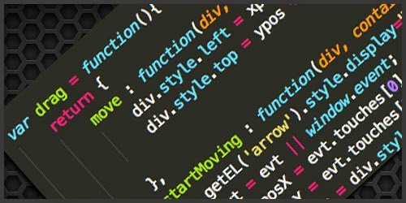
UI ENGINEERING STUDIO
UI Boot Camp: JS
Env
Ecma
ActionScript
Jscript
Javascript
Browser.
Node
ApacheCouch DB
Notes:
Jscript: ms impementation of ecma
ActionScript is an object-oriented programming language originally developed by Macromedia Inc. (later acquired by Adobe Systems)
Browser
Node.js is an open-source, cross-platform JavaScript run-time environment that executes JavaScript code outside of a browser
Apache couchDB: use JavaScript as its query language using MapReduce,

Slide 7
UI ENGINEERING STUDIO
UI Boot Camp: Basics JS
Coercion
true + false
12 / "6"
"number" + 15 + 3
15 + 3 + "number"
[1] > null
"foo" + + "bar"
Type coercion is the process of converting value from one type to another (such as string to number, object to boolean, and so on). Any type, be it primitive or an object, is a valid subject for type coercion.
-MDN
Notes:
Table https://dorey.github.io/JavaScript-Equality-Table/
Null check, default default. foo && foo.baz

Slide 8
UI ENGINEERING STUDIO
UI Boot Camp: Basics JS Scope and context
Every function invocation has both a scope and a context associated with it. Fundamentally, scope is function-based while context is object-based. In other words, scope pertains to the variable access of a function when it is invoked and is unique to each invocation. Context is always the value of the this keyword which is a reference to the object that “owns” the currently executing code.
Ryan Morr
function exampleFunction() { var x = "declared inside scope"; this.x= "context of the function"; console.log(x);
console.log(this.x); }
console.log(x);

Slide 9
UI ENGINEERING STUDIO
UI Boot Camp: Basics JS
Hoisting
Hoisting is JavaScript's default behavior of “moving” all declarations to the top of the current scope.
num = 6; console.log(num); // returns ? var num;

Slide 10
UI ENGINEERING STUDIO
UI Boot Camp: Basics JS
Equal
=== !== == !=

Slide 11
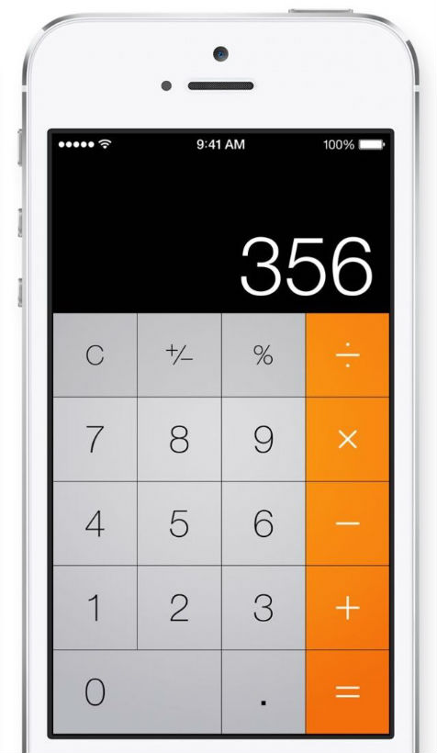
UI ENGINEERING STUDIO
UI Boot Camp: JS Basics Homework: Calculator

Slide 12
Notes:
*

